Slide 1
AVL Tree
Insertion and deletion

Slide 2
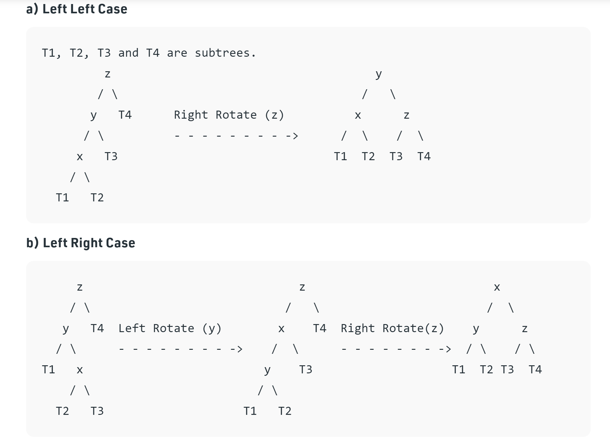
Rotations

Slide 3
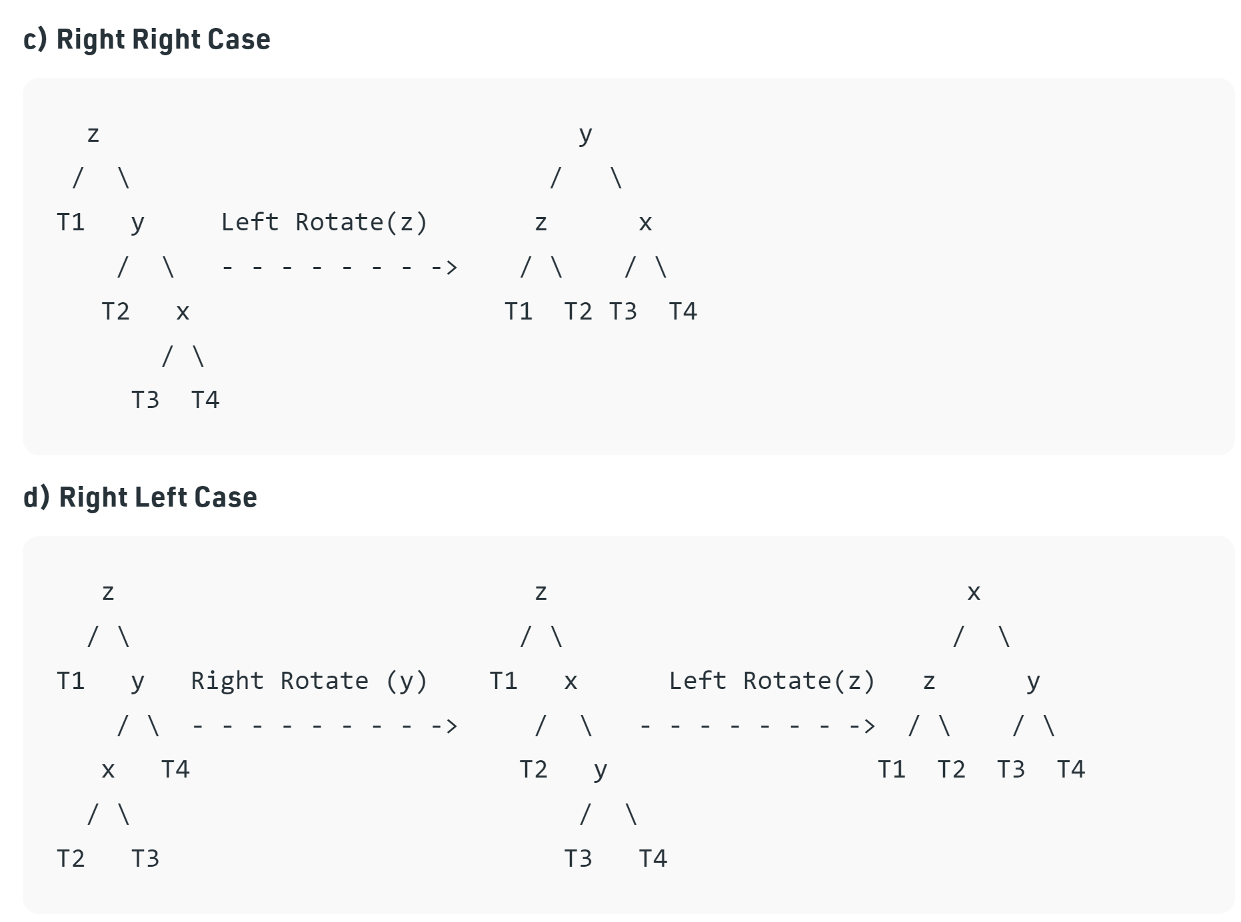

Slide 4
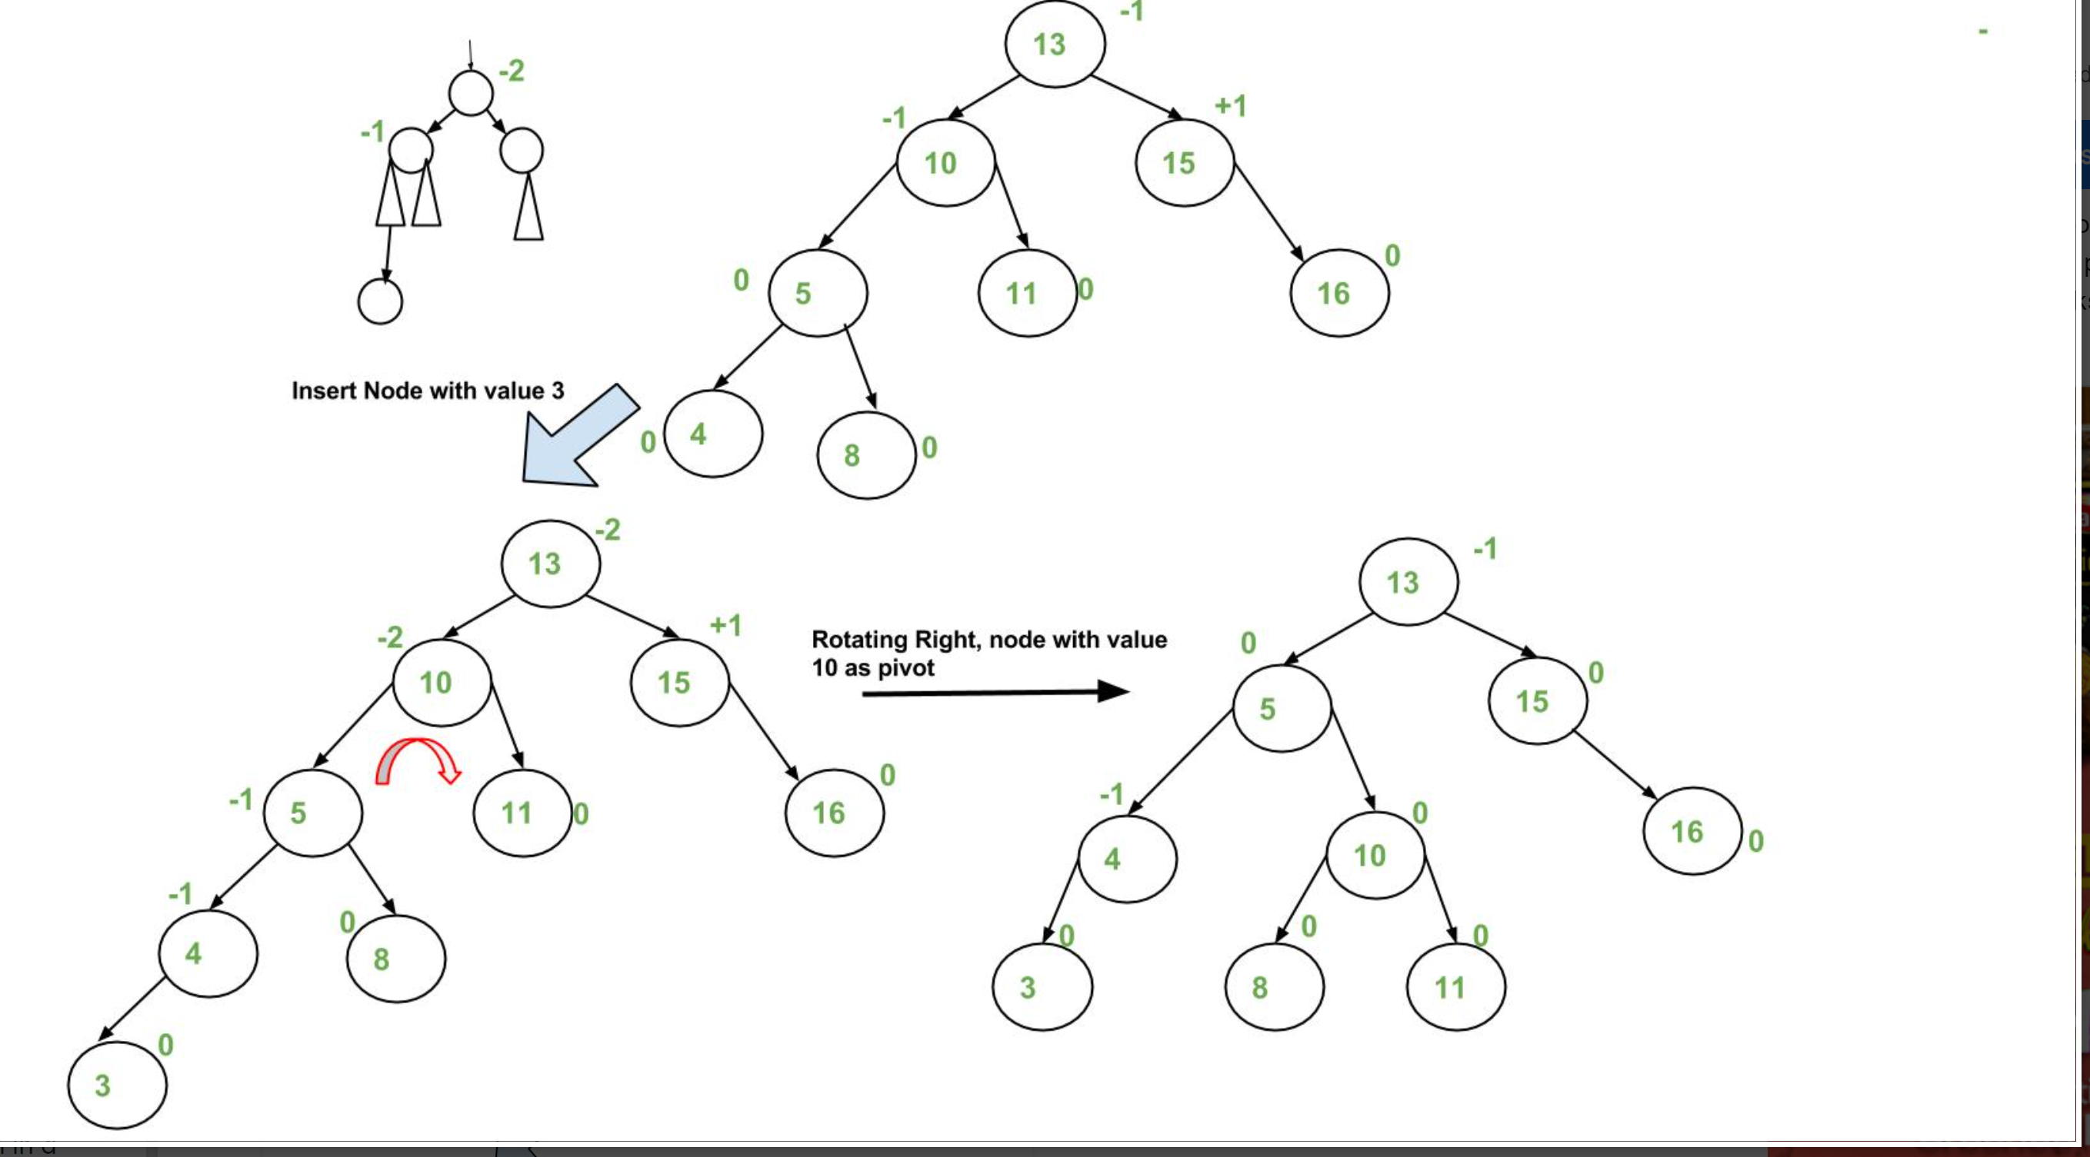
Insertion

Slide 5
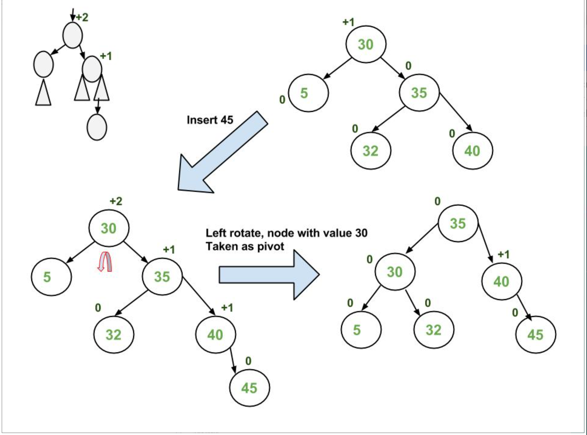

Slide 6
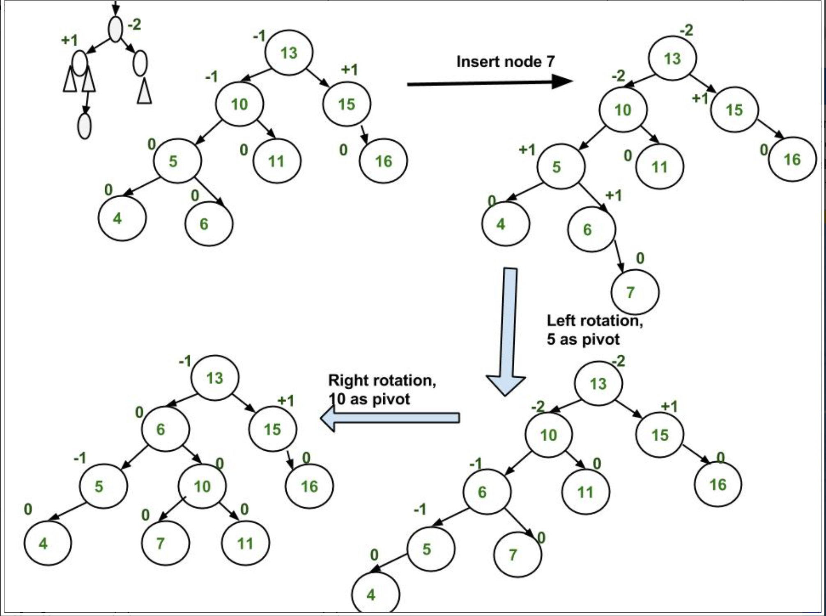

Slide 7
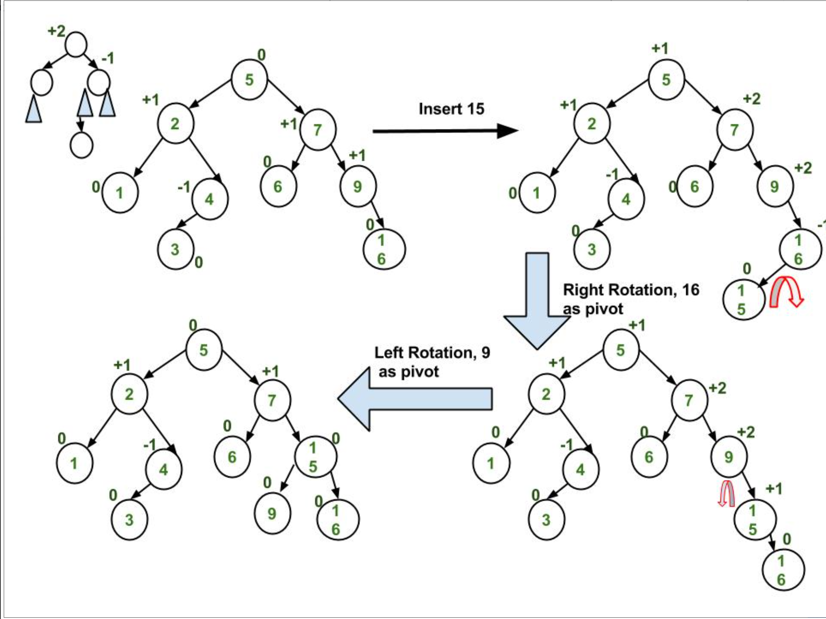

Slide 8
Algorithm
In the recursive BST insert, after insertion, we get pointers to all ancestors one by one in a bottom-up manner. So we don’t need parent pointer to travel up. The recursive code itself travels up and visits all the ancestors of the newly inserted node. 1) Perform the normal BST insertion. 2) The current node must be one of the ancestors of the newly inserted node. Update the height of the current node. 3) Get the balance factor (left subtree height – right subtree height) of the current node. 4) If balance factor is greater than 1, then the current node is unbalanced and we are either in Left Left case or left Right case. To check whether it is left left case or not, compare the newly inserted key with the key in left subtree root. 5) If balance factor is less than -1, then the current node is unbalanced and we are either in Right Right case or Right-Left case. To check whether it is Right Right case or not, compare the newly inserted key with the key in right subtree root.

Slide 9
Deletion
Let w be the node to be deleted 1) Perform standard BST delete for w. 2) Starting from w, travel up and find the first unbalanced node. Let z be the first unbalanced node, y be the larger height child of z, and x be the larger height child of y. Note that the definitions of x and y are different from insertion. 3) Re-balance the tree by performing appropriate rotations on the subtree rooted with z. There can be 4 possible cases that needs to be handled as x, y and z can be arranged in 4 ways. Following are the possible 4 arrangements: a) y is left child of z and x is left child of y (Left Left Case) b) y is left child of z and x is right child of y (Left Right Case) c) y is right child of z and x is right child of y (Right Right Case) d) y is right child of z and x is left child of y (Right Left Case) Like insertion, following are the operations to be performed in above mentioned 4 cases. Note that, unlike insertion, fixing the node z won’t fix the complete AVL tree. After fixing z, we may have to fix ancestors of z as well

Slide 10
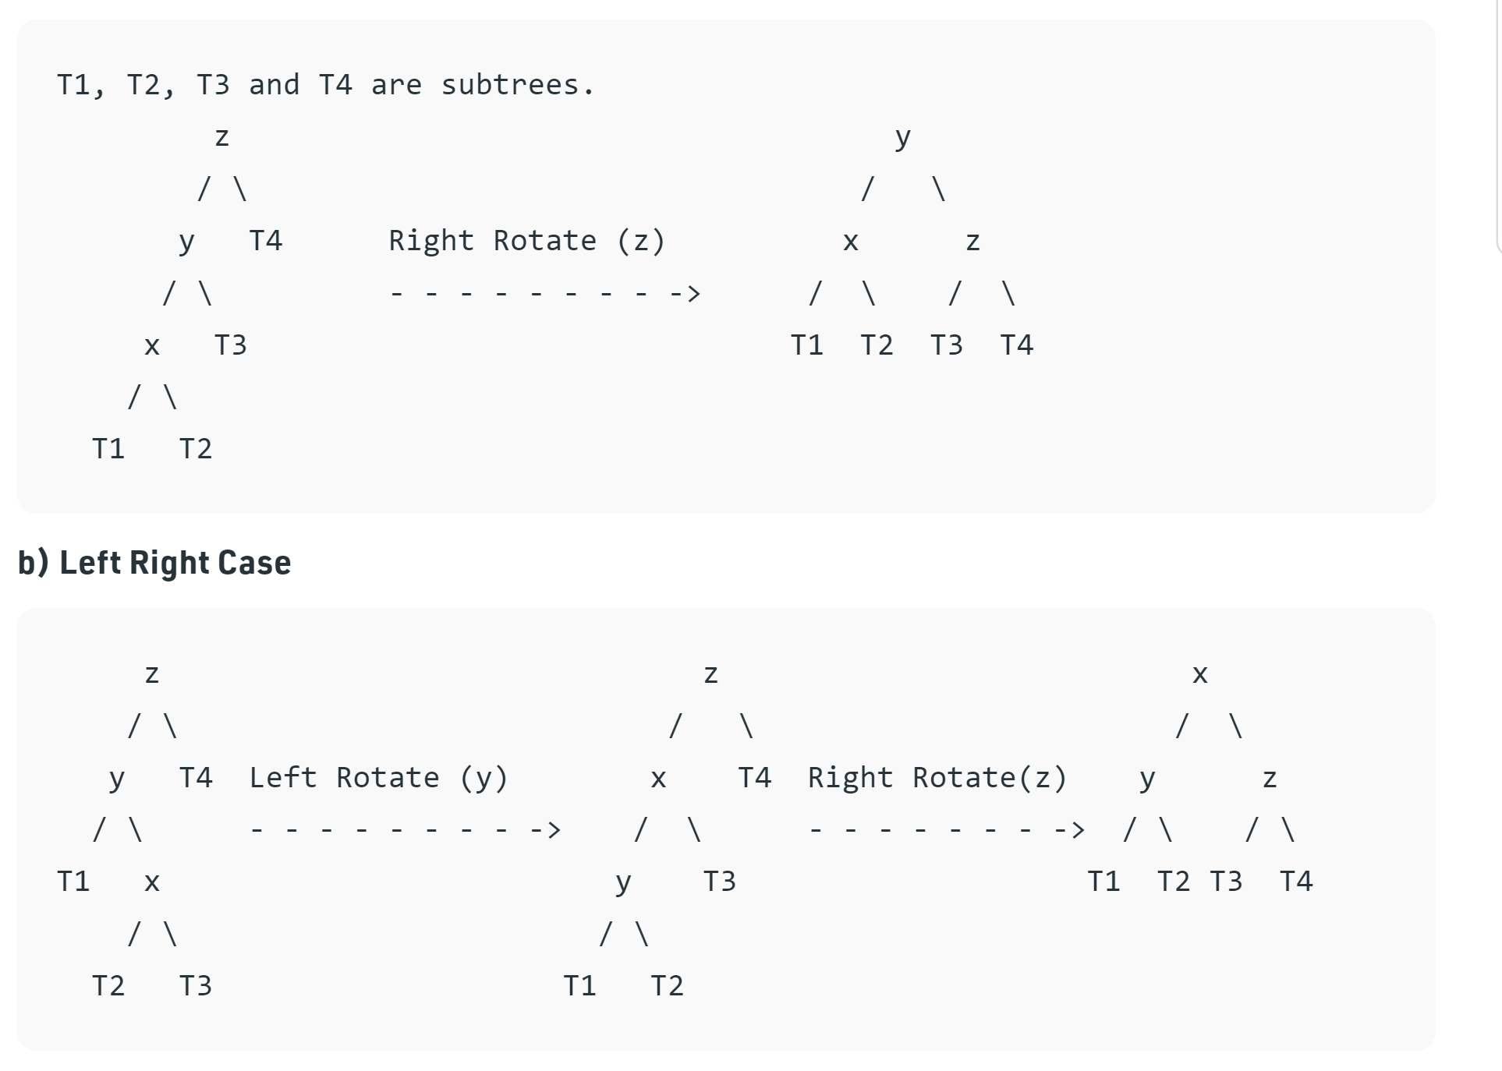
Left Left case

Slide 11
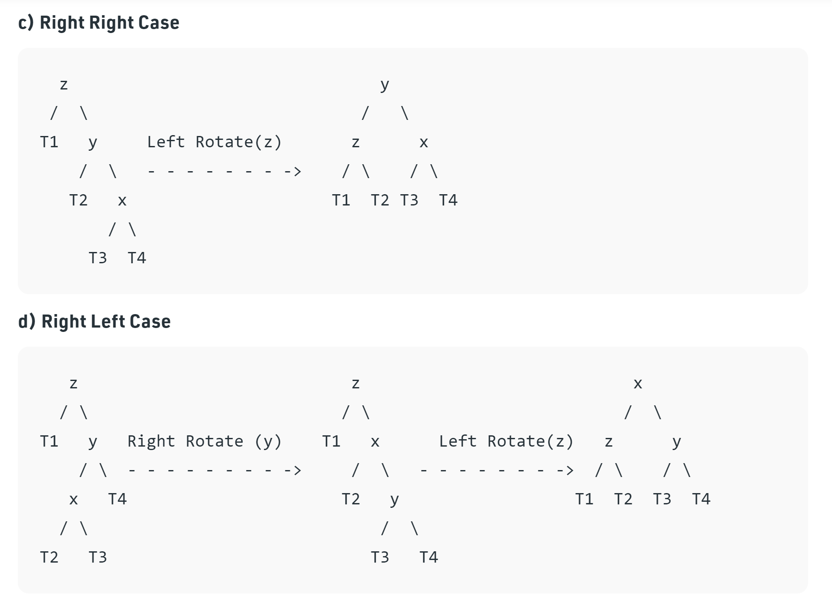

Slide 12
Algorithm
In the recursive BST delete, after deletion, we get pointers to all ancestors one by one in bottom up manner. So we don’t need parent pointer to travel up. The recursive code itself travels up and visits all the ancestors of the deleted node. 1) Perform the normal BST deletion. 2) The current node must be one of the ancestors of the deleted node. Update the height of the current node. 3) Get the balance factor (left subtree height – right subtree height) of the current node. 4) If balance factor is greater than 1, then the current node is unbalanced and we are either in Left Left case or Left Right case. To check whether it is Left Left case or Left Right case, get the balance factor of left subtree. If balance factor of the left subtree is greater than or equal to 0, then it is Left Left case, else Left Right case. 5) If balance factor is less than -1, then the current node is unbalanced and we are either in Right Right case or Right Left case. To check whether it is Right Right case or Right Left case, get the balance factor of right subtree. If the balance factor of the right subtree is smaller than or equal to 0, then it is Right Right case, else Right Left case.

